Slide 1
Parental Information Evening
Choosing an Outstanding Professional Family
6th July

Slide 2
Outline
Update on strategic developments
Taster Days – Parent version
Q and A

Slide 3
Integrated JMF6-Abingdon
Background
Aim – move towards a fully integrated 6th Form
Actions
Withdrawn from the Abingdon 6th Form Consortium
Increase proportion of teaching at Fitzharrys
Add curriculum breadth
Co-ordinate delivery of teaching and learning
Infrastructure developments
Staffing

Slide 4
People
Executive Head ALT – Sarah Brinkley
Head of Fitzharrys School– Will Speke
Head of John Mason School – Adrian Rees
Director of JMF6-Abingdon – Ed Duckham/Julia Preston
Deputy Director of JMF6 –Abingdon (JMS) Natalie Uzzell
Deputy Director of JMF6 –Abingdon (FZ) Caroline Scott
JMF6 Administrator – Jenny Cooke
Duke of Edinburgh Co-ordinator – Etienne Edwards
JMF6 Tutors
Samantha Drewett Claire Pennington
Jatinder Dhiman Fitzharrys Tutor – to be decided
Gemma Fulton Fitzharrys Tutor – to be decided

Slide 5
The Ethos
Different students need different opportunities.
Students need more than academic development.
Students need to become effective global citizens

Slide 7
The Professional Student
Meet standards to ensure success as a student
Make right choices of a subject area in which to become an expert
Develop character and personal skills that allows you to meet the standards, and become an expert

Slide 8
Choosing subjects
IAG
Taster week
Post-results
Interviews
More IAG
Pilot phase

Slide 9
Character Development
Enrichment programme
Duke of Edinburgh Gold
Work Experience
Extended Project Qualifications (EPQ)
Residentials
Tutor Programme
Ongoing Professional Development
Leadership Opportunities
Mentoring and Monitoring

Slide 10
Allocation of student time
50 hours over two weeks
30 hours for 3 A-Levels
3 Hours Duke of Edinburgh
2 hours EPQ
10 Hours of allocated Independent Study (Supervised or unsupervised)
5 hours ‘free’

Slide 11
Enrichment time
1 hour for D of E Gold Expedition Training
1 hour for D of E Skills
1 hour for Physical
2 hours for EPQ

Slide 12
Duke of Edinburgh Award
Builds
Resilience and self-reliance
Sharing responsibility
Decision making and acceptance of consequences
Reflection on personal performance
Confidence in unfamiliar situations
Develop communication skills and coping mechanisms
Show initiative
Develop research skills
Sense of achievement
Learn about and appreciate community and sense of belonging

Slide 13
The DofE is…
You achieve an Award by completing a personal programme
of activities in four sections:
Volunteering: undertaking service to individuals or the community.
Physical: improving in an area of sport, dance or fitness activities.
Skills: developing practical and social skills and personal interests.
Expedition: planning, training for and completion of an adventurous journey in the UK or abroad.
At Gold level, you must do an additional Residential section, which involves working and staying away from home doing a shared activity.

Slide 14
Gold Award (16+ years old)
Volunteering | Physical | Skills | Expedition | Residential
12 months | One section for 12 months and the other section for 6 months |  | Plan, train for and complete a 4 day, 3 night expedition | Undertake a shared activity in a residential setting away from home for 5 days and 4 nights
Direct entrants must undertake a further 6 months in either the Volunteering or the longer of the Physical or Skills section.

Slide 15
Gold in Year 12
All students who enrol at JMF6 will participate in all aspects of the programme as part of enrichment
Students can opt to complete the residentials and expeditions to ensure that they complete the award
There is a financial cost of participation. Full support can be offered to help meet this commitment.

Slide 16
Volunteering
Une tutor time session a week to plan for the delivery of a lunchtime club for Year 7 students. Students will need to maintain commitment to the delivery of this club for a period of 6 months to meet the requirements of the Award.
Or
Students can arrange their own volunteering from a list of options

Slide 17
Skills
A choice of four different skills to take part in during enrichment sessions. They will be given either instruction or practice time for two session a fortnight so that they can meet the requirement of showing progress. They need to sustain involvement in this for a period of 6 months.
Or
Students can arrange their own skills from a list of options

Slide 18
Physical
Use the Enrichment Programme to take part in a relevant physical activity.
Or
Students can arrange their own Physical Activity from a list of options

Slide 19
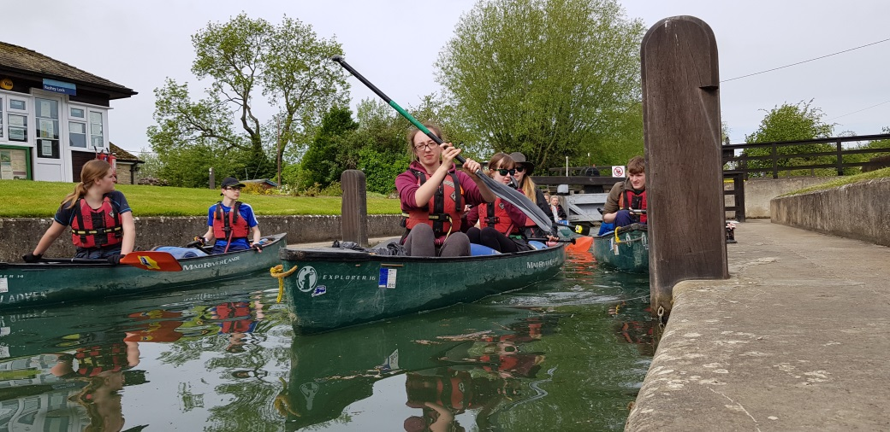
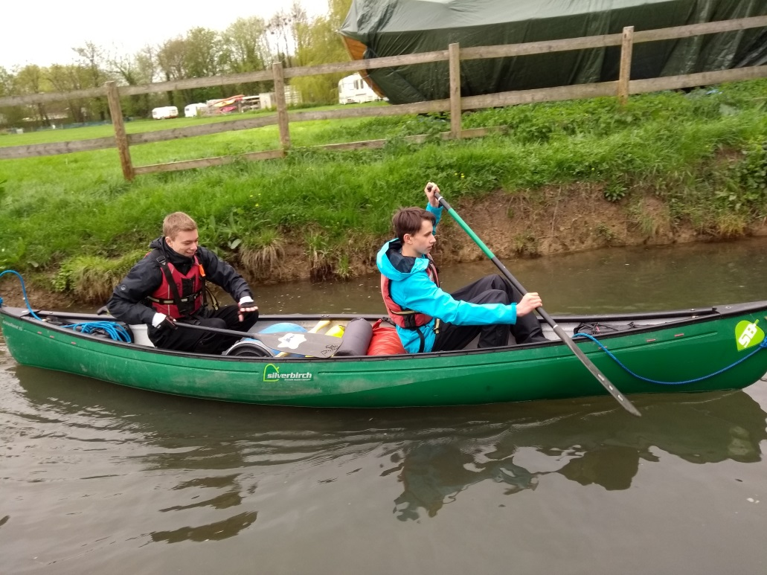
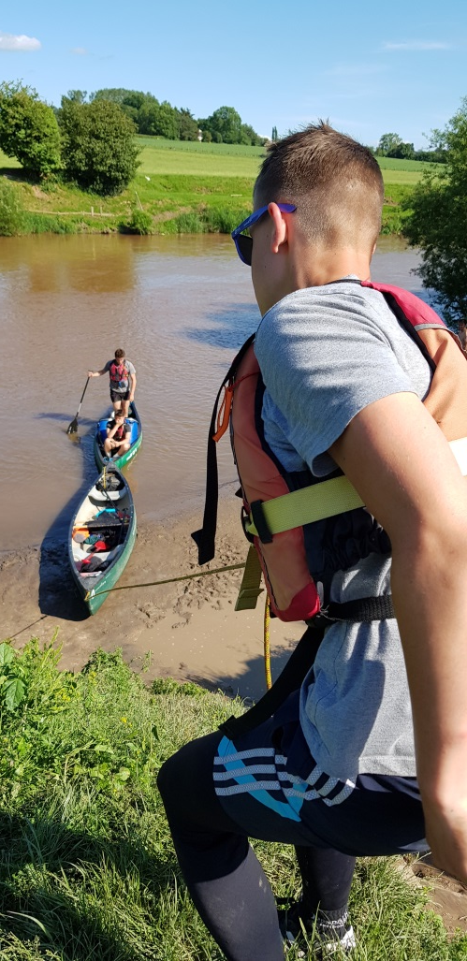
Expedition

Slide 20
Expedition
Training for the expedition element for one hour a week.
Instruction in all the skills required to undertake all of the Expedition elements.
Training Days/Practice Expedition–– Abingdon – May Half Term- Basic canoe training and/or campcraft as appropriate
Qualifying Expedition – September Year 13 - 4 nights - Canoeing – Wye Valley

Slide 21
Residential
Students are required to arrange a 4 day residential experience for themselves.
They will receive full advice and guidance on this aspect
Options
Supporting their old primary school in a trip
archaeological digs
Camps International in Costa Rica
The NCS programme.

Slide 22
Commitment to the Community
As part of JMF6 you will be expected to provide leadership and role modelling for the wider school community. This will for the most part involve participation with Lower school students

Slide 23
Extended Project Qualification
Key part of JMF6-Abingdon is to build personal skills and improve chances of opportunities post 18
The Extended Project Qualification
One hour a week taught
Two hours a week independent study

Slide 24
Helping you stand out
The EPQ allows each student to embark on a largely self-directed and self-motivated project. Students must choose a topic, plan, research and develop their idea and decide on their finished product.
A finished product may take the form of a:
research based written report
production* (eg charity event, fashion show or sports event etc)
an artefact* (eg piece of art, a computer game or realised design)

Slide 25
The Process
Choose an area of interest and draft a project title and aims.
Plan, research and carry out a project.
Keep a production log of all stages of the project production, reviewing and evaluating progress.
Complete the project product.
Prepare and deliver a presentation.

Slide 26
Why?
Stand out
Study beyond the normal syllabus
Develop independent learning
Develops the transferable skills
Work on a subject about which they are passionate
Adds Flexibility to A-level options
UCAS Points – reduced offers in other subjects

Slide 27
Work Experience Week
2nd Week in July 2023
Compulsory for all Year 12 students

Slide 28
Different to year 10
The focus of this Work Experience is different from that completed in Year 10
develop the basic employability skills they gained at Year 10
search for one which gives them the ‘next level’ of experience and skills
gain a placement at managerial level
look for a placement outside of county at a national or multi-national company
directly related to their current course
directly related to their career intentions

Slide 29
Logistics
Communication – Parent mail, new web-site, parents evenings, progress checks
Location – standardised 6th Form Facilities across both schools.
Attendance – Full attendance is expected from 8.30 to 3.10 each day
Access - come and go access, using photo ID card
Support – Tutor – Student Managers - Faculty staff – Director/Deputy Director of Sixth Form

Slide 30
What next
Tasks
Transition Work
Research choices/DofE/EPQ/Work Experience
Enrolment
Interview post results
Final decision on options can be as late as September

Slide 31
Key Dates
Thursday 25th August - Exam results
Thursday 25th-Friday 26th – Enrolment interviews – Main Hall, JMS
5th September – Year 12 Induction and lessons
20th September - Parents Information evening tbc

Slide 32
Key Dates
Duke of Edinburgh Gold Expedition Commitments
Initial Canoe Basic Training – Single school day in September
Gold Practice Expeditions
Sat 27th May 2023 – Mon 29th May
Tues 30th – Thurs 1st June
Fri 2nd June – Sun 4th June – Yr 12 – River Thames
Gold Assessed Expeditions
Sat 16th Sept – Weds 20th Sept
Weds 20th Sept – Sun 24th September 2023
Other dates
10th-14th July - Work Experience tbc

Slide 33
Q and A
Are they allowed to retake a GCSE subject and will they get lessons for it or is it independent study?
Taught sessions are provided to support English Language and Maths GCSEs only if the students does not reach Grade 4.

Slide 34
Q and A
My son is starting a new subject at A-Level. What happens if a few weeks into the course, he decides he doesn't like it?
Some flexibility to change in the first couple of weeks if for a good educational reason. Much more difficult to catch up with a new subject if left longer.

Slide 35
Q and A
Is there anything parents need to do to enrol their child or is it all done by the students themselves?
For current Y11 students at Fitzharrys or John Mason, the process is automatic in most cases. Students joining us from elsewhere may need your support to complete an enrolment form.

Slide 36
Q and A
Will there be updates as to progress?
There will be three termly progress checks and up to two Parent Consultation Evenings each year.

Slide 37
Q and A
What equipment is required for A levels (notebooks, laptops)?
Students can access school Chromebooks on both sites or bring their own device in to school.
Subject teachers may provide recommendations for revision guides/calculators etc. and these are generally cheaper to buy through the school.

Slide 38
Q and A
Are phones allowed to be used during school hours?
Yes – phones can be used in lessons and around the school – this should be in line with our Professional Standards and mindful of a 11-18 mixed school cohort.

Slide 39
Q and A
Is DofE Gold compulsory?
We encourage all to take part in the timetabled sessions for the benefit it provides to students. The Expedition aspect has a cost involved, but there are bursaries and support available if cost is an issue.

Slide 40
Q and A
When will they be told which forms they’re in?
Timetables with tutor groups will be issued on Monday 5th September. Students will have some input at the enrolment interview as to who they would like/not like to be with

Slide 41
Q and A
Will there be parent evenings?
Up to two consultations per year in sixth form.

Slide 42
Q and A
Will children in the sixth form be able to use either of the schools' canteens?
Students can use either canteen via a cashless biometric system. Most students choose to visit local establishments such as Tesco Express or McDonalds…

Slide 43
Q and A
What will a typical day at Sixth Form be like?
Students are expected in school from 8.30am – 3.10pm. When not in lessons or registration, students can access the study facilities at both sites. Lessons are blocked into two sessions before break; two more before lunch and afternoon registration plus one further lesson in the afternoon.

Slide 44
Q and A
Is there a possibility of having to do online learning?
Ideally not, but cannot be ruled out at the moment. We are well practised and set up for this if it does happen.

Slide 45
Q and A
When are the timetables for year 12 released ?
Students will receive a copy of their timetable on Monday 5th September. Once everyone is enrolled and on our systems, we will revert to electronic communication for updated timetables.

Slide 46
Q and A
What sports / PE options will there be in 6th form?
Students have one hour per fortnight timetabled for PE as part of their DofE programme.
The Senior Student Team Sports Committee provide various other options for sports and exercise through clubs and tournaments.

