Slide 1
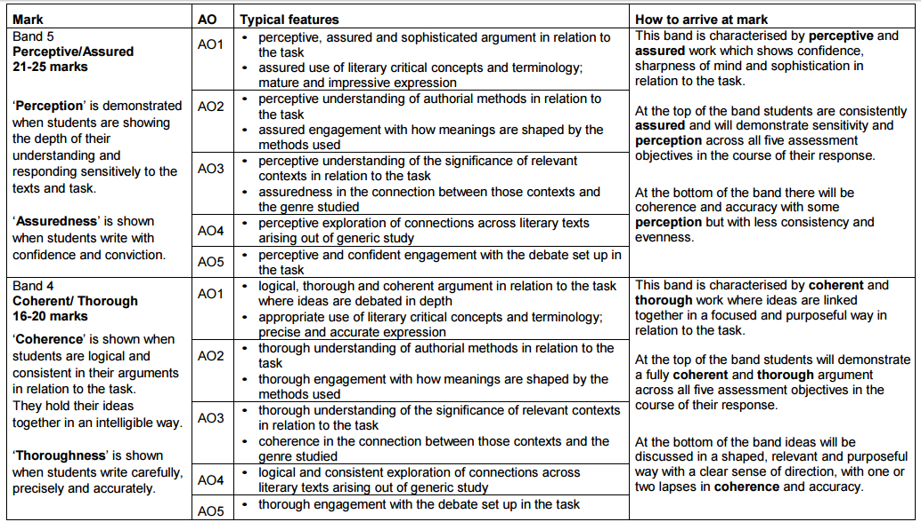
A2 Mock PLC
Name:
Date:
Weightings for each question are as follows: AO1: 7 marks; AO2: 6 marks; AO3: 6 marks; AO4: 3 marks; AO5: 3 marks

Slide 2
Students will need to be able to discuss:
the type of the text
the settings - both places (real and imagined) and temporal (time) settings
the specific nature of the power struggle, the behaviours of those with power and those without, those who have their hands on the levers of power (characterisation)
the pursuit of power itself, rebellion against those with power, warfare
the workings of the ruling political classes
corruption, conspiracy, control
the connection of the smaller world to the larger world
the focus on human organisation: domestically, in the work place, in local and national governments
gender politics and issues of social class
the structural patterning of the text, how political tensions are heightened and perhaps resolved
the way that language is used in the worlds that are created
the way that political and social protest writing is used to comment on society, particularly the representation of society at particular historical periods
ultimately how political and social protest writing affects audiences and readers, inviting reflection on our own world

